Slide 1
Entrance Exams and their effect
Assessment for Learning
Paper 4th – Unit 1
Mrs. Neela Chaudhary
IASE Bilaspur (C.G.)

Slide 14
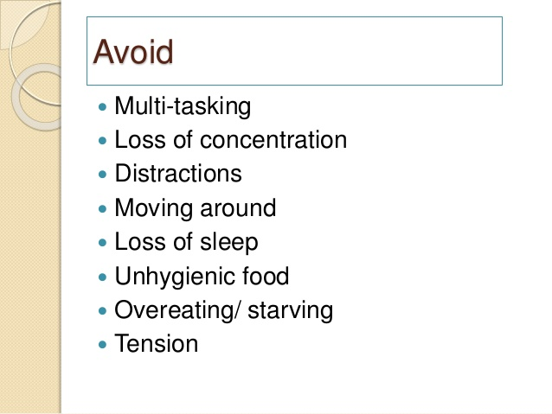

Slide 15
Effect on School
Schools refine their teaching process.
School give orientation about different competitive exams.
School motivate their students and post-students play a important role on it.
School change their routine time table according exams
School enrich library with a lot of reference book to facilitate students.
Students Selection in entrance exams improve the effectiveness of school.
Many schools give guidance about entrance exams.
Schools differ in curriculum, skill development and assessment process.

Slide 16
Effect on Student
Students have fear of entrance exams, so many times they depressed or disappointed.
Mostly school culture not improve the entrance exam skills in student, so they diverted to professional coaching institutions.
Students face difficulty in entrance exams because of difference between school curriculum and entrance exam syllabus.
Students feel difficulty to manage coordination school exam system and entrance exam system.
Many students do not want to join classes in school during their preparation of entrance exams, because schools take their long time in regular classes.
Entrance exams give stress and disappointers because of their specific nature and lack of knowledge about it.
Entrance exams give a opportunity to students for their future career.
Mainly entrance exams identify students aptitude, attitude, value and interest level.
Sometimes entrance exams do not discriminate child's ability.

Slide 17
Conclusion
So, today it is must coordination between school curriculum and entrance exams syllabus.
It is also necessity of todays that coaching institutions assist the schools.
Schools should play a important role to develop career skills in child according to their individual differences.

